Slide 1


BICYCLE ACCIDENTS PREVENTION PROJECT
Organization Name
Pedal Proof Bicycle Accident Prevention Project
Group 8
Data Engineering Group Members
Yogesh Meka,
Teja Sai Srinivas Kunisetty,
Divyasree Pithani,
Siva Karthik Sangaraju,
Pranavi Battula,
Sai Bhargav Dasaraju

Slide 2

BICYCLE ACCIDENTS PREVENTION PROJECT
• Overview
• Proposed Solution
• Generation
• Collection
• Processing
• Storage
• Management
• Next Steps: Analysis, Visualization, & Interpretation
Yogesh Meka

Slide 3
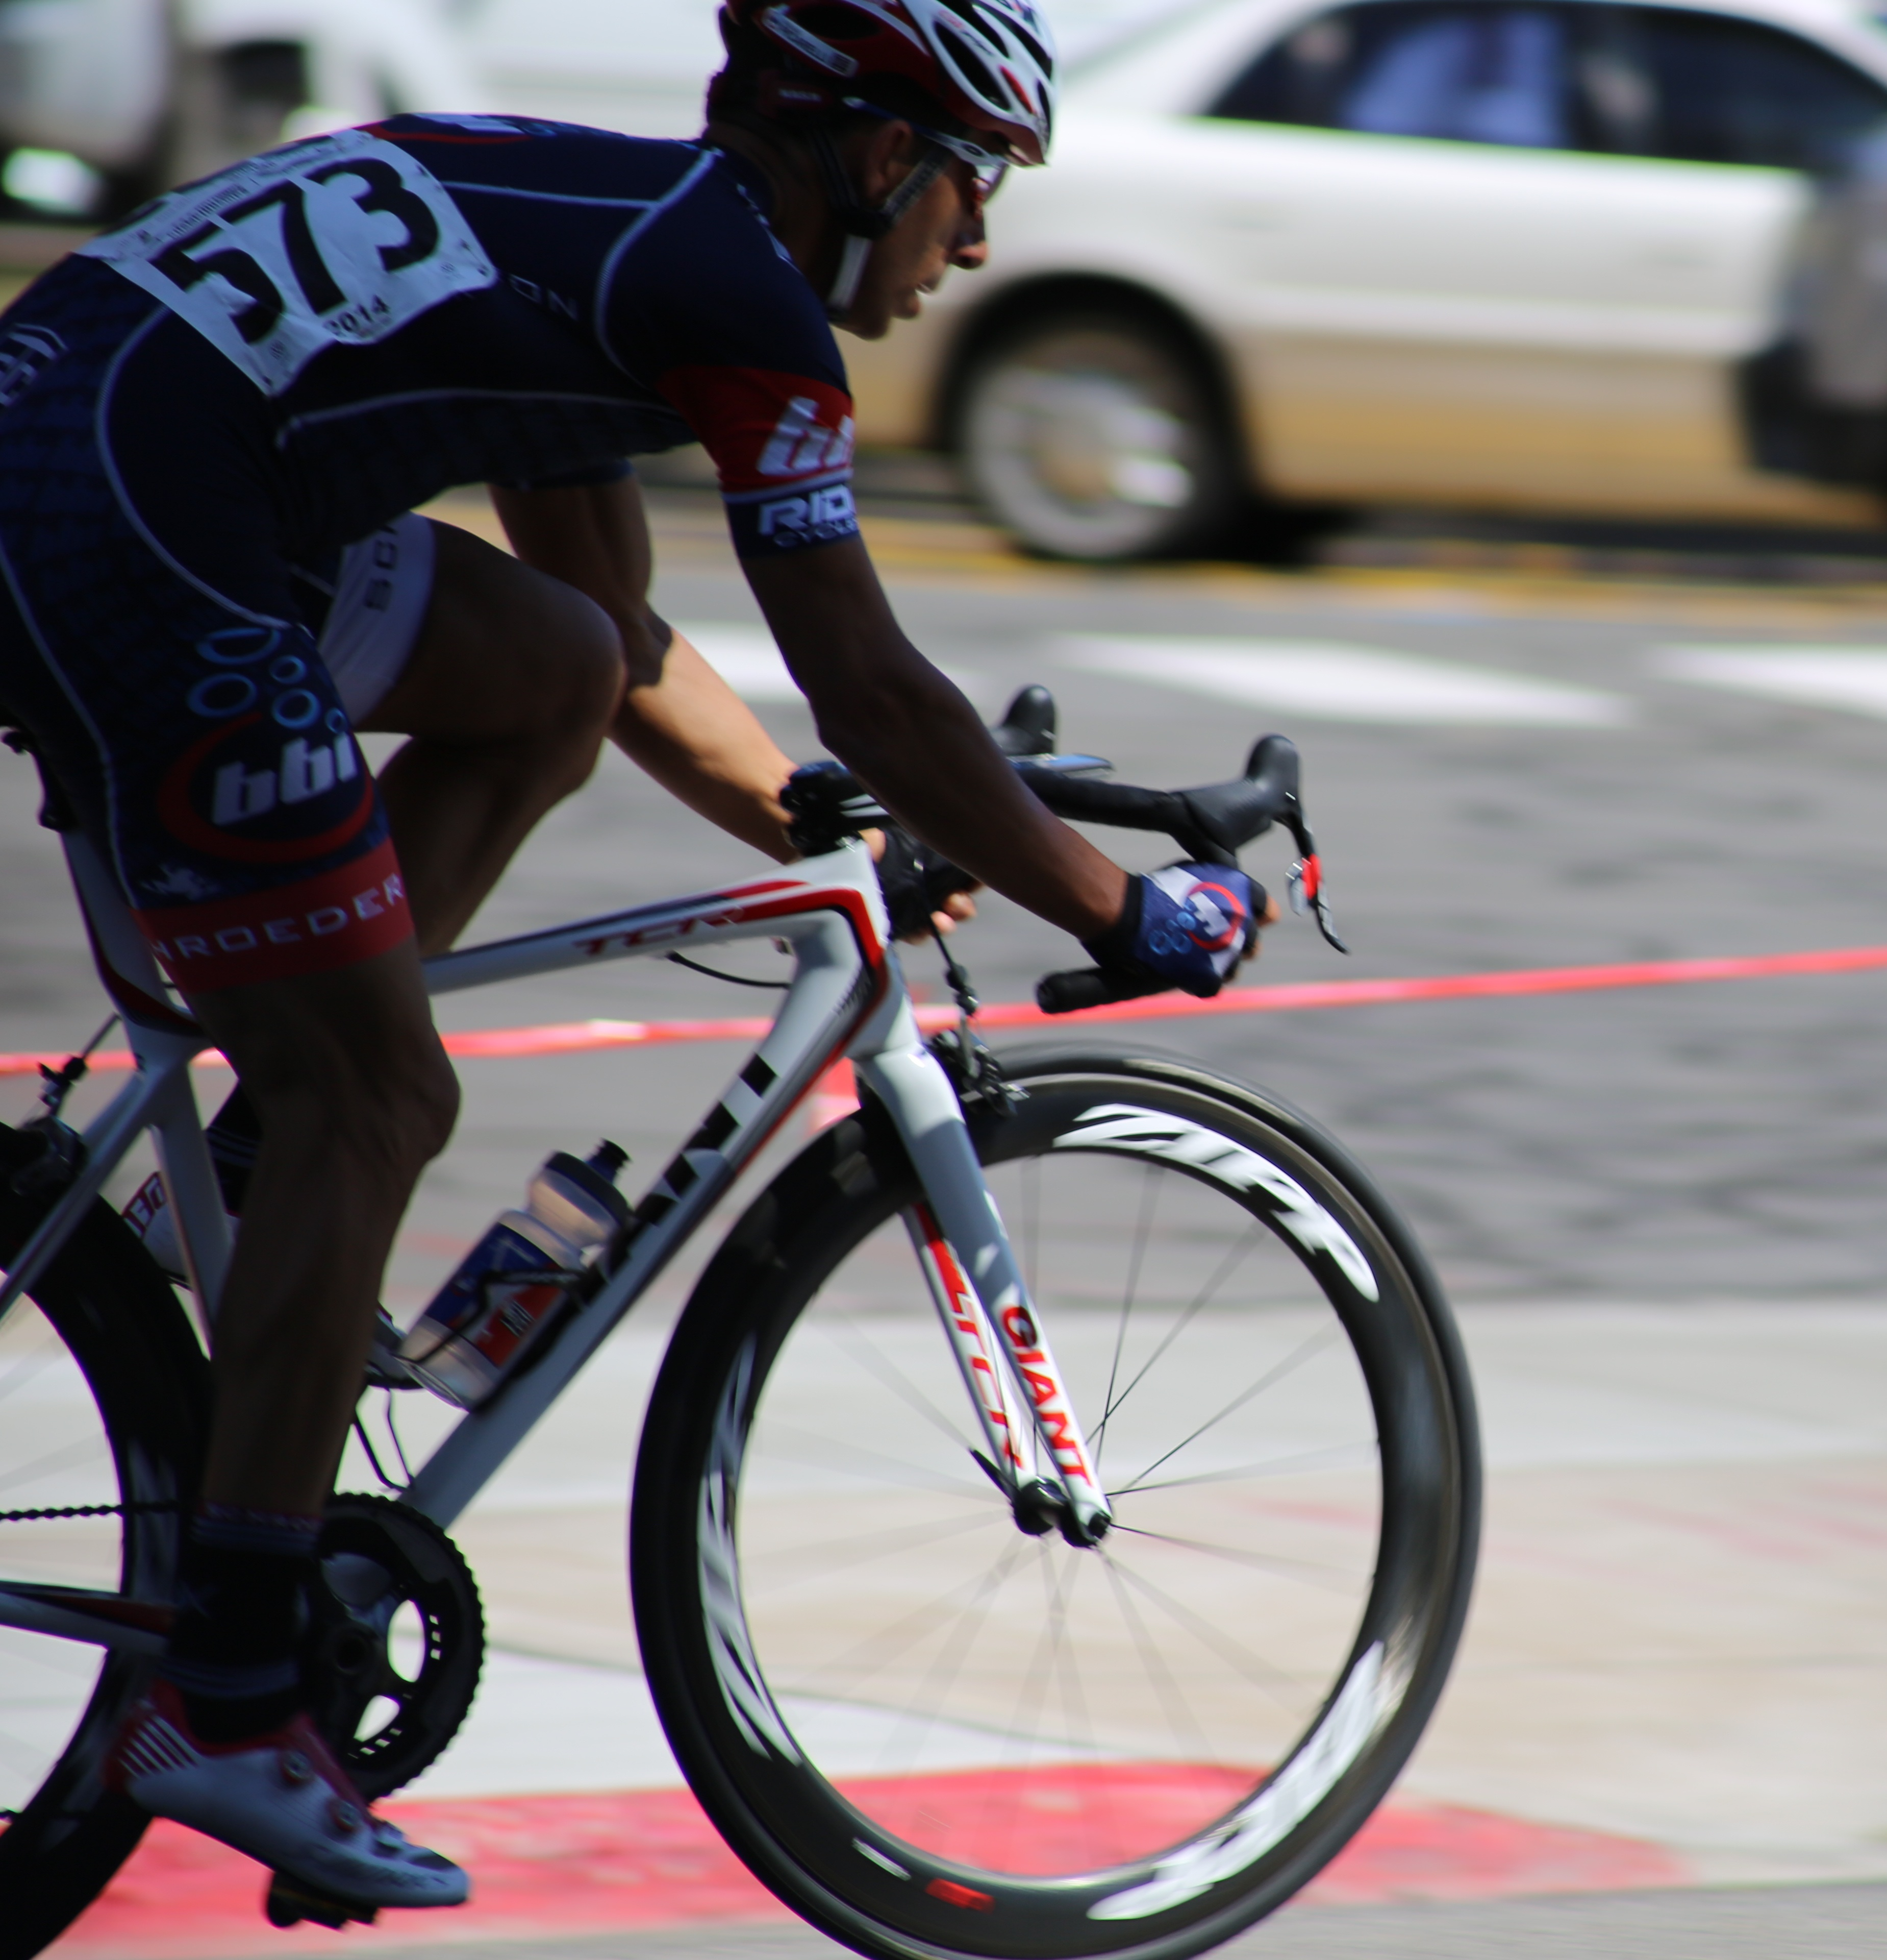
Overview
Unsafe street conditions, careless drivers, and a dearth of designated bike lanes are the main causes of collisions.
These collisions frequently cause fatalities or severe injuries, endangering the lives of riders.
In order to promote healthier, sustainable mobility and make our streets safer, these issues must be resolved.
Yogesh Meka

Slide 4

Proposed Solution
Our group of data engineers took the lead in the battle to improve bike safety.
We suggested applying data engineering expertise to construct a clever, cloud-based framework that would reveal latent trends in collisions and assist communities, cyclists, and municipal planners in making streets safer.
Siva Karthik

Slide 5
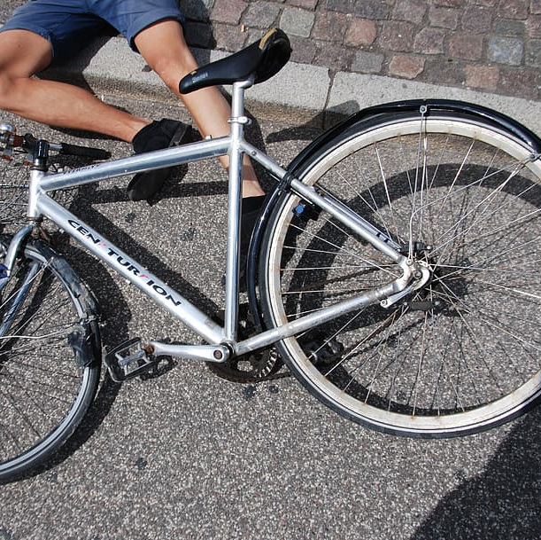
Generation
In order to address the issue of bicycle accidents, we have located publicly accessible data sources.
• San Diego police collision reports (related to pedal cyclists)
• Tempe, Arizona crash data report information
• Records of cyclist crashes from the open data site in New York City
Pranavi

Slide 6
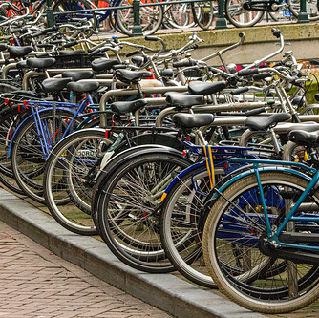
Collection
The following datasets were successfully gathered:
Pedal cyclist collision records from San Diego's open data portal
Detailed crash report data from Tempe's city database
Public safety records of cycling crash incidences from New York City.
Pranavi
This Photo by Unknown Author is licensed under CC BY

Slide 7
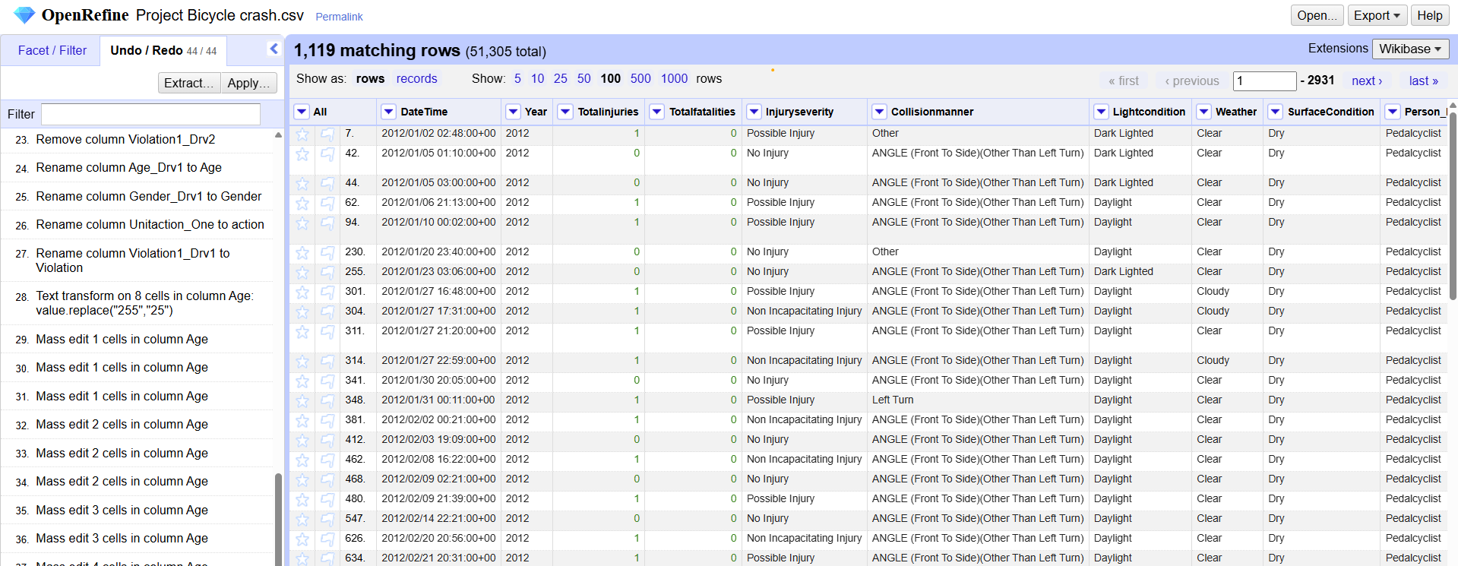
Processing
We utilized OpenRefine to clean up the crash records because the data we gathered wasn't entirely clean.
To ensure accurate analysis, we eliminated unwanted columns, fixed outliers, and standardized field formats.
Divyasree

Slide 8
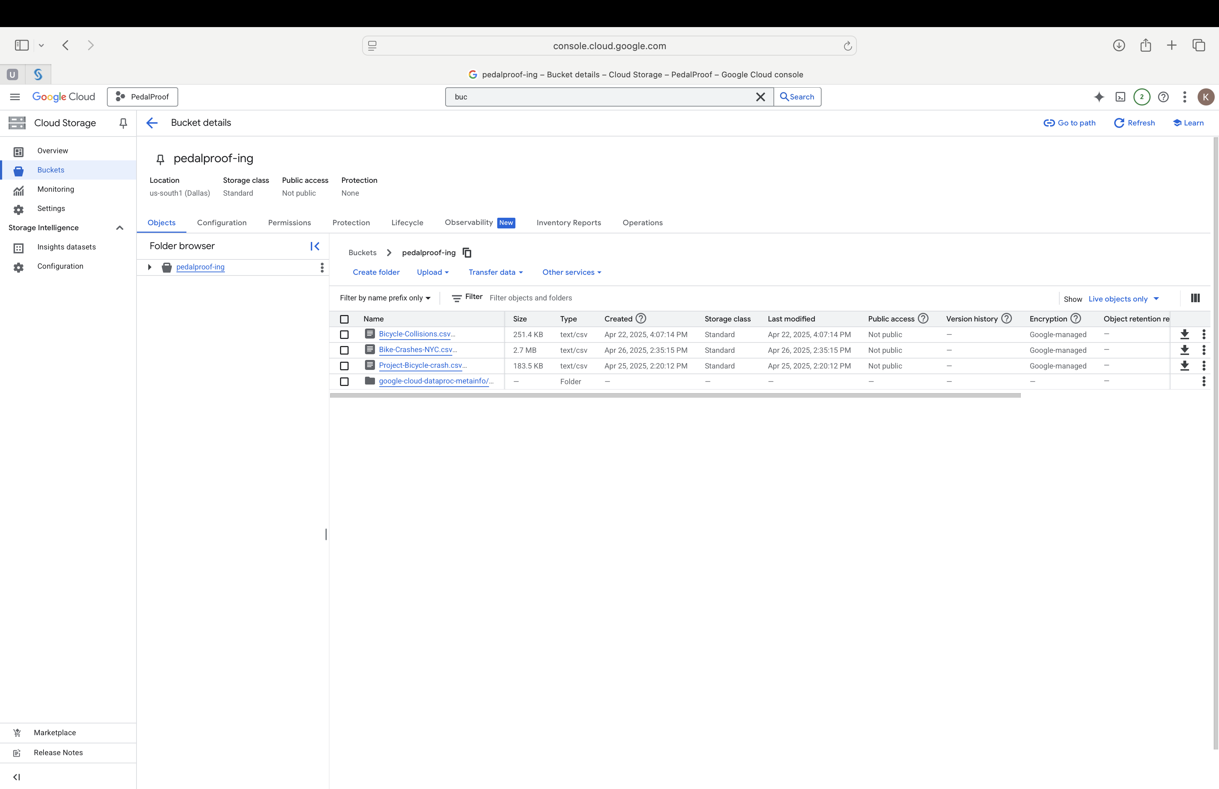
Storage
Our preferred cloud provider is Google Cloud Platform (GCP), and every processed data file is safely kept in a GCP bucket.
The storage configuration guarantees the bicycle crash datasets' safe management, scalability, and ease of access.
Bhargav

Slide 9
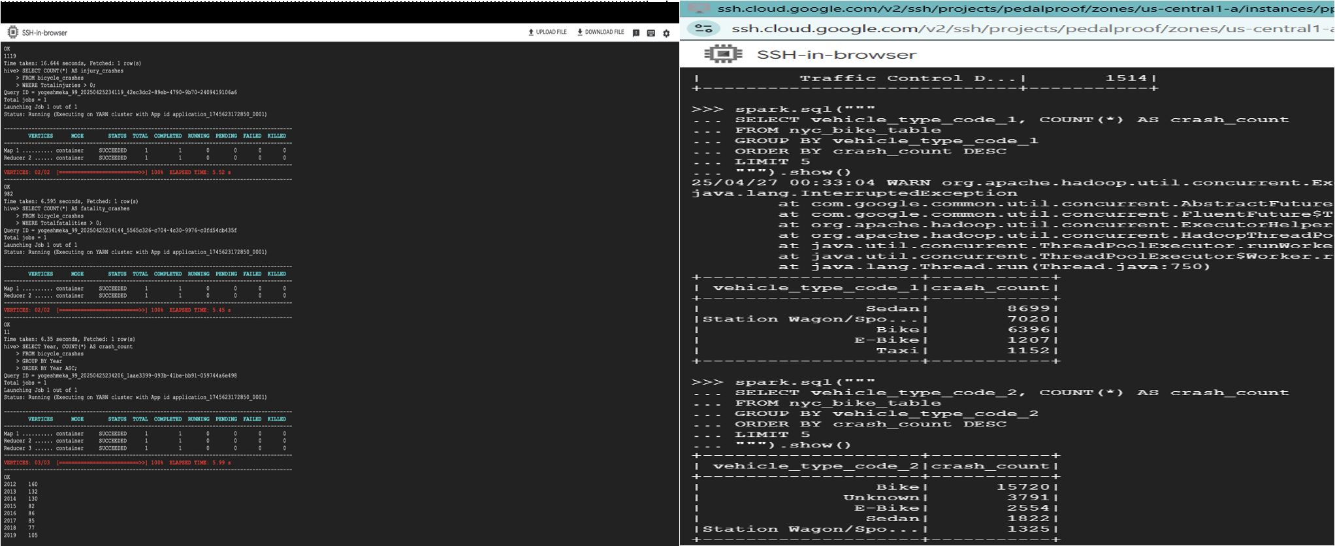
Management
Google Cloud Platform tools and services allow us to manage our data seamlessly.
We are using BigQuery, Spark, and Hive to query, process, and organize the datasets for further analysis.
Sai Teja

Slide 10
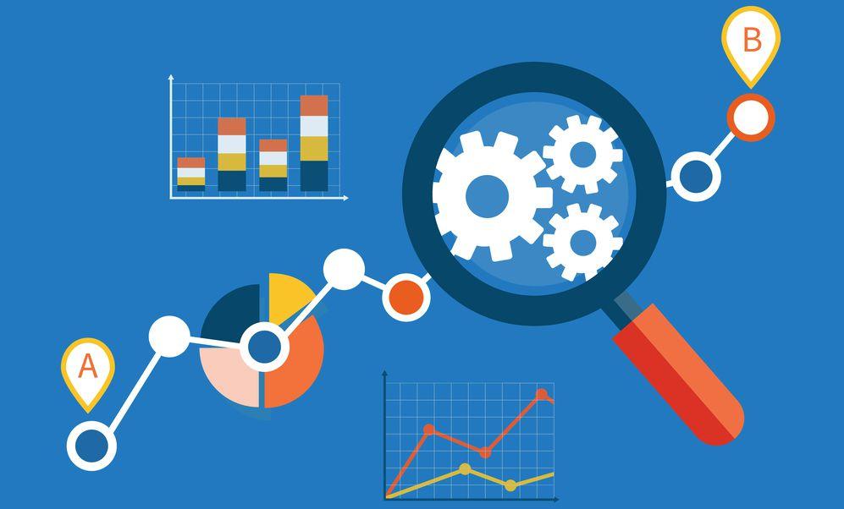
Next Steps: Analysis, Visualization, & Interpretation As the data engineering team, we have built a clean and reliable data infrastructure for the project. The datasets are ready for deep analysis, visualization, and interpretation using tools like Tableau.
This Photo by Unknown Author is licensed under CC BY-ND
Sai Teja

Slide 11
References
Data.gov. (n.d.). The home of the U.S. Government’s open data. U.S. General Services Administration. Retrieved April 28, 2025, from https://www.data.gov/
Google Cloud. (n.d.). Google Cloud Platform documentation. Retrieved April 28, 2025,
from https://cloud.google.com/docs
OpenRefine. (n.d.). OpenRefine: A free, open-source tool for cleaning and transforming data. Retrieved April 28,2025, from https://openrefine.org/
Apache Hive. (n.d.). Apache Hive documentation. The Apache Software Foundation.
Retrieved April 28, 2025, from https://cwiki.apache.org/confluence/display/Hive/Home
Apache Spark. (n.d.). Spark SQL, DataFrames and Datasets Guide. The Apache Software Foundation. Retrieved April 28,2025, from https://spark.apache.org/docs/latest/sql-programming-guide.html
Google Cloud. (n.d.). BigQuery documentation. Retrieved April 28, 2025, from https://cloud.google.com/bigquery/docs
Siva Karthik & Divyasree

Slide 12
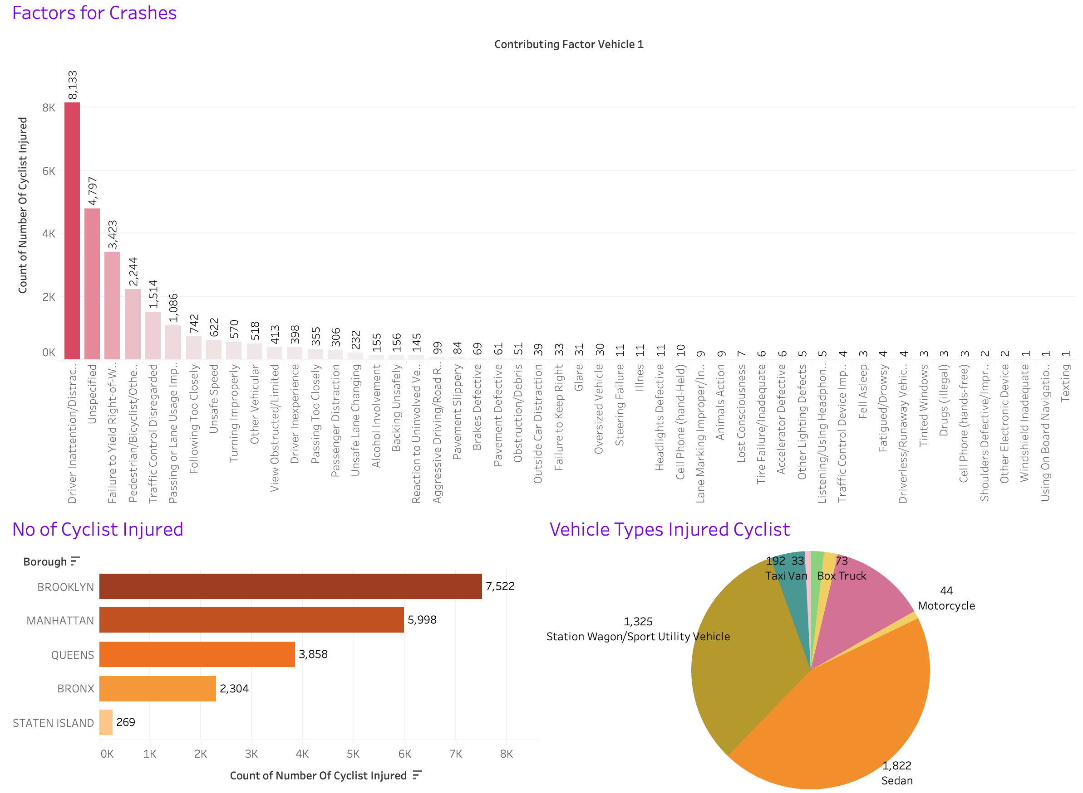
Bonus: Next Steps
We identified high-risk regions and conditions for cyclists by looking at crash records by borough, contributing factors, vehicle types, and crash timing.
Out of all the boroughs, our data showed that Brooklyn has the most bike accidents.
Better traffic management, better bike lane planning, and focused public awareness campaigns are just a few of the safety efforts that will be fueled by these findings.
Siva Karthik & Bhargav

